Slide 1
Maven Fuzzy Factory Analysis Using SQL And Power-BI
B. Dattesh, DAG 7

Slide 2
The Situation:
You’re just been hired as an e-commerce data analyst for Maven Fuzzy Factory an online retailer which has just launched their first product.
The Brief:
As a member of the startup team you will work with the CEO the Head of Marketing and the website manager to help steer the business.
You will analyse and optimize marketing channels, measure and test website conversion performance and use data to understand the impact of new product launches.
The Objective:
Use SQL and Power BI:
Access and explore the Maven Fuzzy Factory Database.
Become the data expert for the company and the go-to-person for mission critical analyses.
Analyse and optimize the business making channels, website and product portfolio.

Slide 3
About the Company:
Maven Fuzzy Factory is a fictional E-Commerce retail company, focused on stuff animal sales. The Company been launched on march 2012 has been operational for three years with the providence of its website activities tracking the customers sessions of sales and the generated revenue.
Company Products:
The Original Mr. Fuzzy
The Forever Love Bear
The Birthday Sugar Panda
The Hudson River Mini bear
Business Task:
Analyze and optimize marketing channels.
Measure and Test the website Conversion performance.
Use the data to Understand the impact of new product launches.

Slide 4
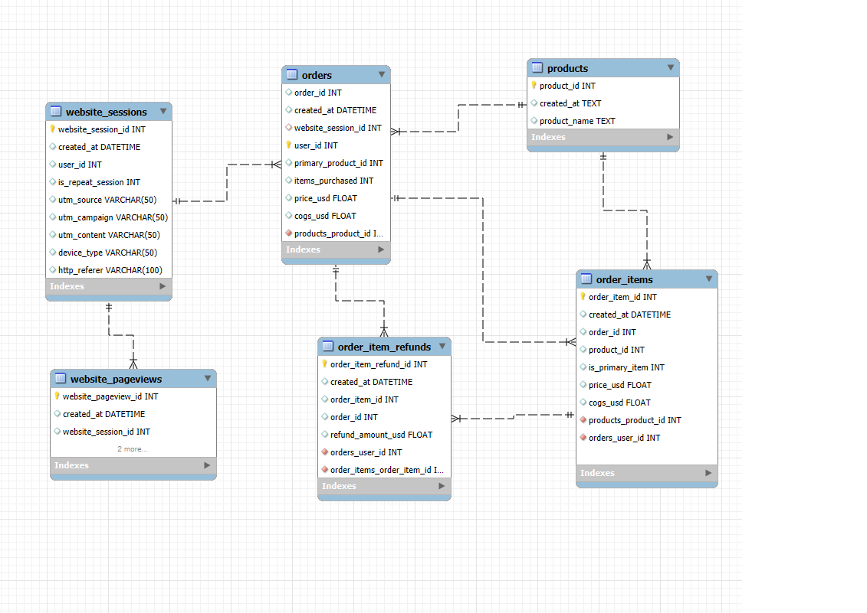
About the dataset
This project utilizes a custom-built e-commerce database for Maven Fuzzy Factory. The data is a part of "Advanced SQL : MySQL Data Analysis & Business Intelligence" course by Maven. Dataset can be downloaded Kaggle.com It covers the products and performance of an ecommerce startup.
The database contains six related tables with eCommerce data about:
Website Activity
Products
Orders

Slide 5
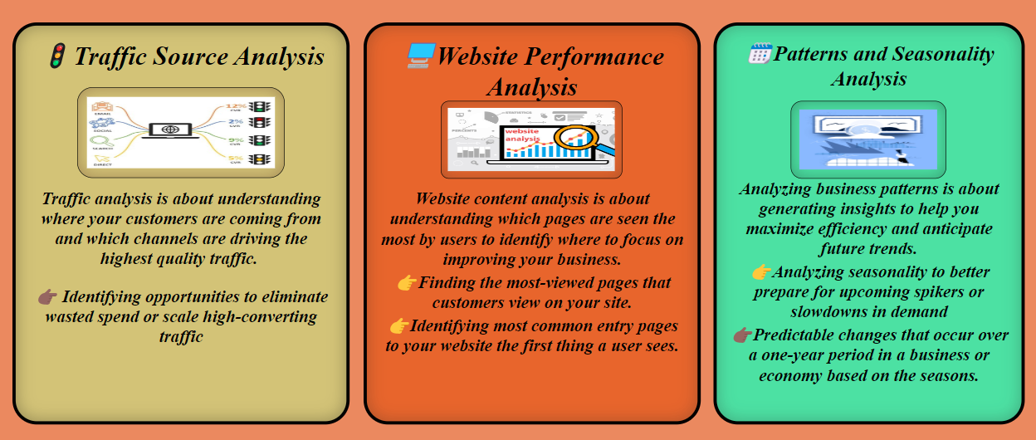

Slide 6
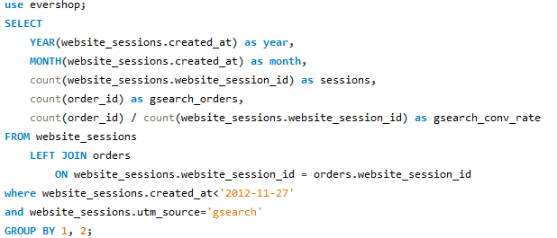
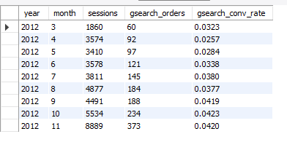
1.G search seems to be the biggest driver of our business. Could you pull monthly trends for G search sessions and orders so that we can showcase the growth there?

Slide 7
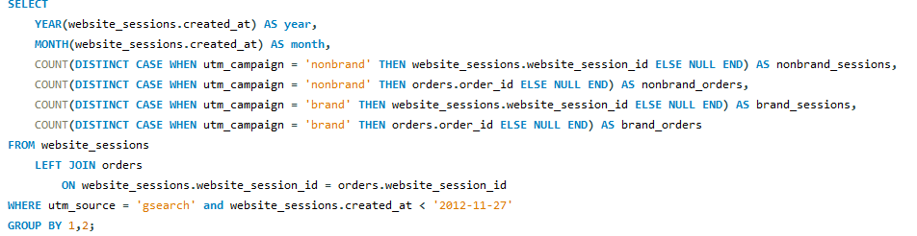
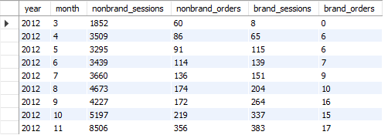
2.Next, it would be great to see a similar monthly trend for G search, but this time splitting out nonbrand and brand campaigns separately. I am wondering if brand is picking up at all. If so, this is a good story to tell.

Slide 8
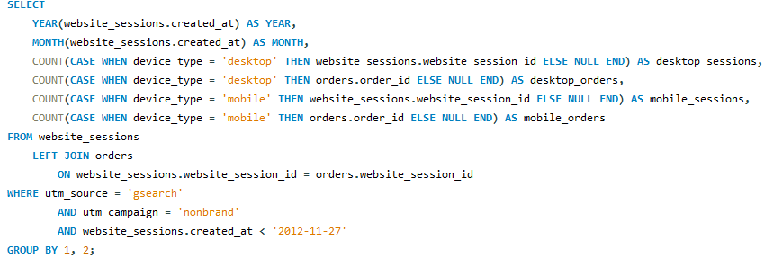
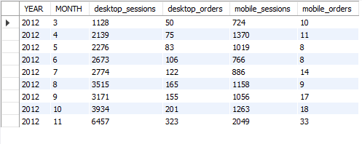
3.While we’re on G search, could you dive into nonbrand, and pull monthly sessions and orders split by device 3 type? I want to flex our analytical muscles a little and show the board we really know our traffic sources.

Slide 9
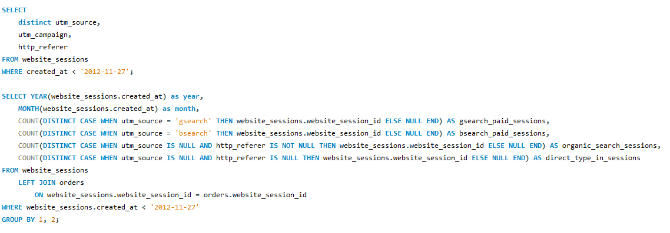

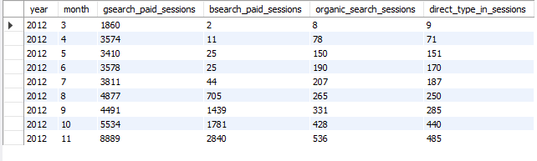
4. I’m worried that one of our more pessimistic board members may be concerned about the large % of traffic from 4 G search. Can you pull monthly trends for G search, alongside monthly trends for each of our other channels

Slide 10
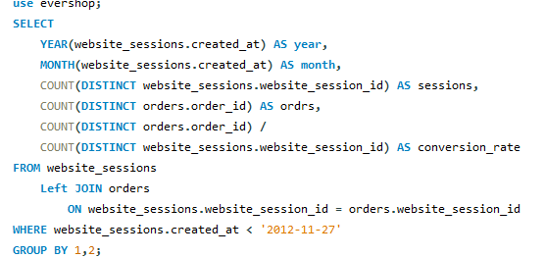
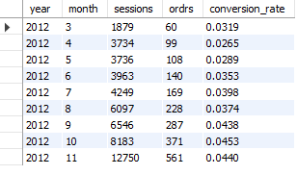
5. I’d like to tell the story of our website performance improvements over the course of the first 8 months. Could you pull session to order conversion rates, by month?

Slide 11
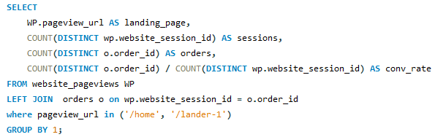


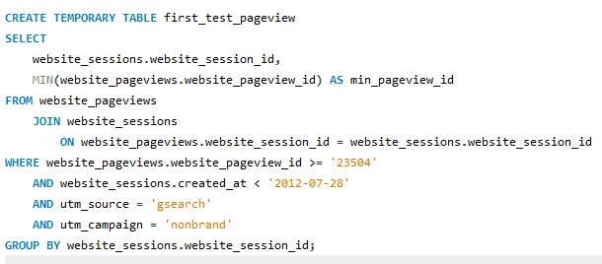
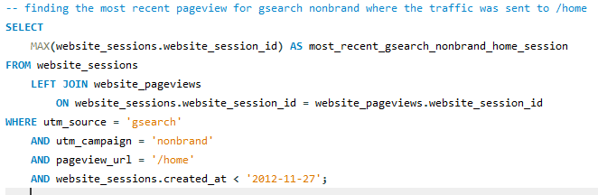

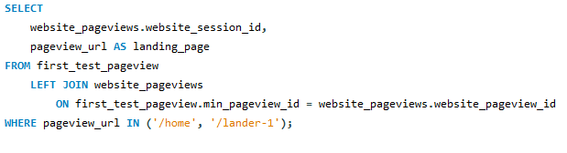
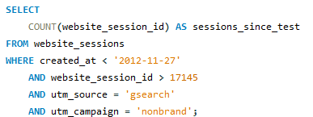

6.For the gsearch lander test, please estimate the revenue that test earned us (Hint: Look at the increase in CVR from the test (Jun 19 – Jul 28), and use nonbrand sessions and revenue since then to calculate incremental value)

Slide 12

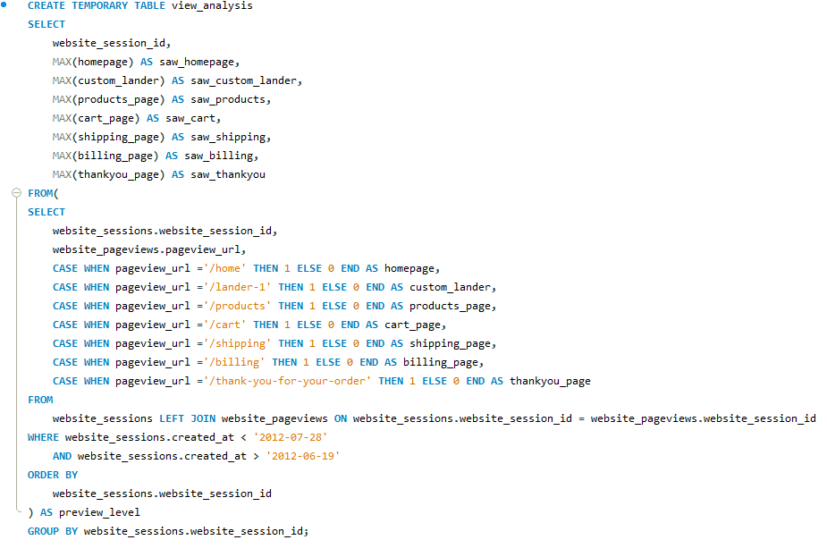
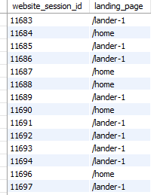
7. For the landing page test you analyzed previously, it would be great to show a full conversion funnel from each of the two pages to orders. You can use the same time period you analyzed last time (Jun 19 – Jul 28).

Slide 13
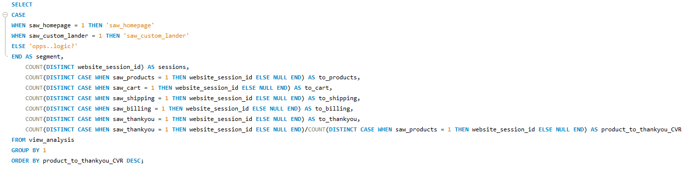

Slide 14
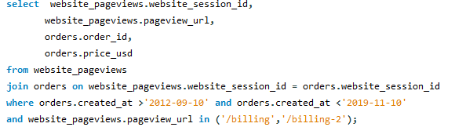
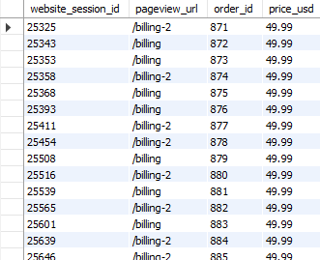
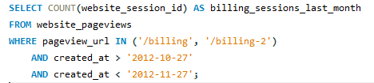

8. I’d love for you to quantify the impact of our billing test, as well. Please analyze the lift generated from the test (Sep 10 – Nov 10), in terms of revenue per billing page session, and then pull the number of billing page sessions for the past month to understand monthly impact.

Slide 15
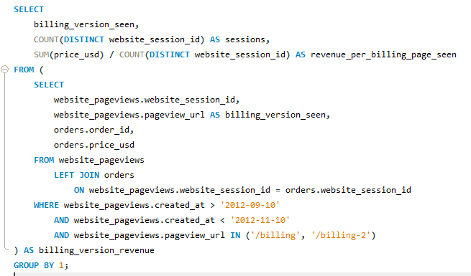

As we got increase of 31.339-22.826 = 8.512 dollars has increased per session seen by changing billing page to billing-2 page
Result is 1311 sessions are there in last month.-- 1193*8.512= 10,154.816 dollars are the last month revenue from billing-2 page change test-- $10,154 revenue last month

Slide 16
Observation: The result shows that the company's major traffic sources are “gsearch utm_source” and “nonbrand utm_campaign”. The second highest traffic to the website is through organic and direct search without any paid campaigns.
Observation: Bsearch utm_source with brand utm_campaign has the most session to order conversation rate of 8.86% followed by gsearch – brand and organic/direct search. Socialbook-desktop_targeted and socialbook-pilot has the lowest. Hence it might be a good idea to decrease the budget for those campaigns and allocate it to others.
Observation: It seems like the product and home pages get most of the traffic among the five major pages listed. It will be a great idea to focus on enhancing these two pages for the best customer experience.
Observation: It seems like the original homepage still has more sessions than the custom lander page but the conversation rate from the customer selecting products to buying it is higher for the custom lander page. The custom lander page has a conversation rate of 8.68% whereas for the homepage it is 8.16%. Customers seem to be liking the new lander page and are more likely to purchase product when directed through the new lander page.
Observation: The session to order conversation looks great for the business as it has grown from 3.2% since starting the business in 2012 to 8.4% in the most recent quarter of 2015. Similarly, we see a drastic increase in revenue per order and revenue per session as well.
Observation: We see a spike in sales in the months November and December, every year for all the products and hence. The trend is most probably because of the holiday season as online retail attracts more customers. We also see high revenue in February months for the product lovebear. The product was targeted at couples for gifts. So, we see a large spike in revenue around Valentine’s Day.
Observation: Overall, the company seems to have increased its total revenue and margin since its start in 2012. The business seems profitable, and the increasing revenue trend seems promising.

Slide 17
Suggestions
I am advised to invest more money in non-branded search advertisements that focus on device types with strong conversion rates. To attract more relevant traffic, examine search queries and improve keyword targeting.
Create a marketing schedule that takes seasonal trends into account. To take advantage of increasing demand, give marketing top priority at busy times of the year and think about introducing unique specials or time-limited deals. To prevent stockouts, make sure the inventory and supply chain are ready for these times as well.
Set aside a certain amount of the budget to experiment with fresh marketing approaches and new traffic sources. Keep a careful eye on their performance and be ready to escalate efforts that prove successful. To keep ahead of the competition in digital marketing, remain flexible and attentive to emerging trends.
Create a procedure for continuing analysis and improvement. Examine user behavior, sales statistics, and campaign performance on a regular basis to find new areas for development. Utilize data-driven insights to guide choices and modify plans of action as necessary.

Slide 18
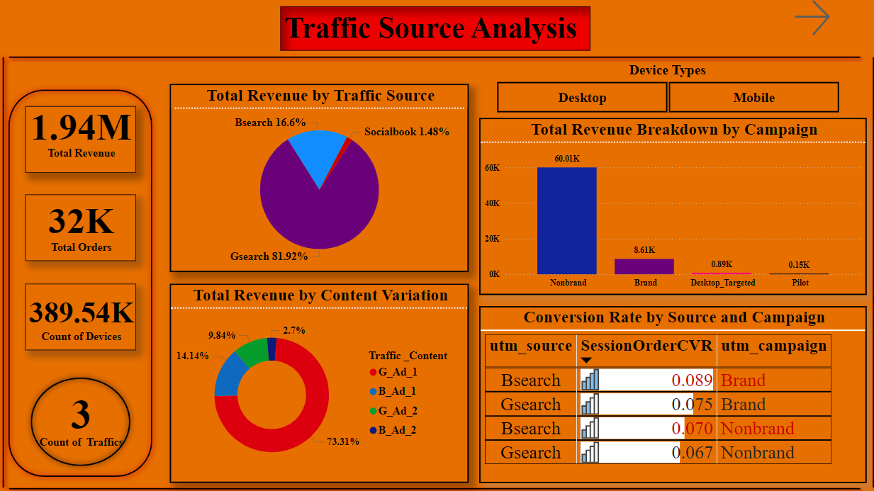
Power BI Dashboards and Visualizations
Power BI Report Link:

Slide 19
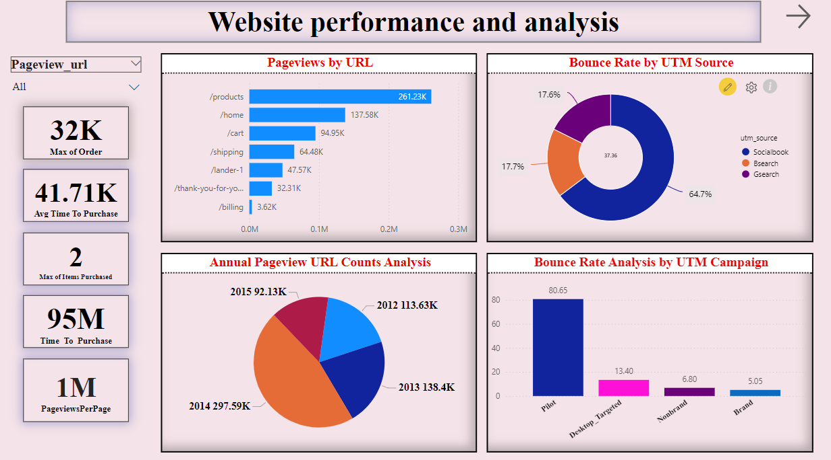

Slide 20
